Slide 1
Cloud Security Audit &
Penetration Testing

Slide 2
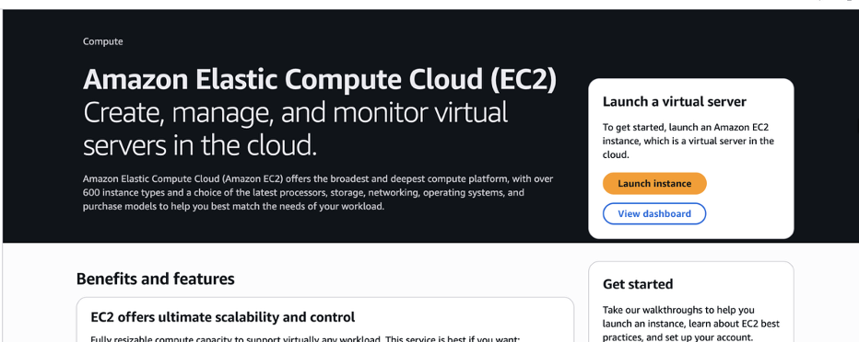
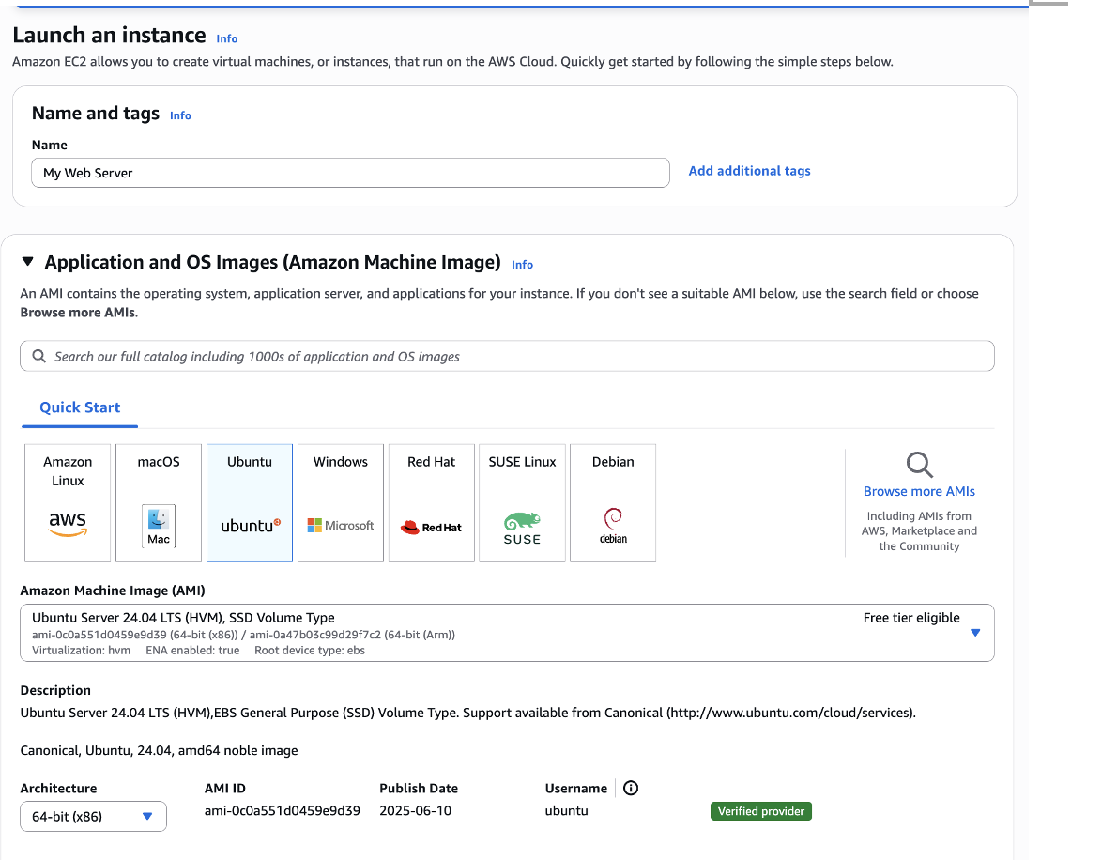
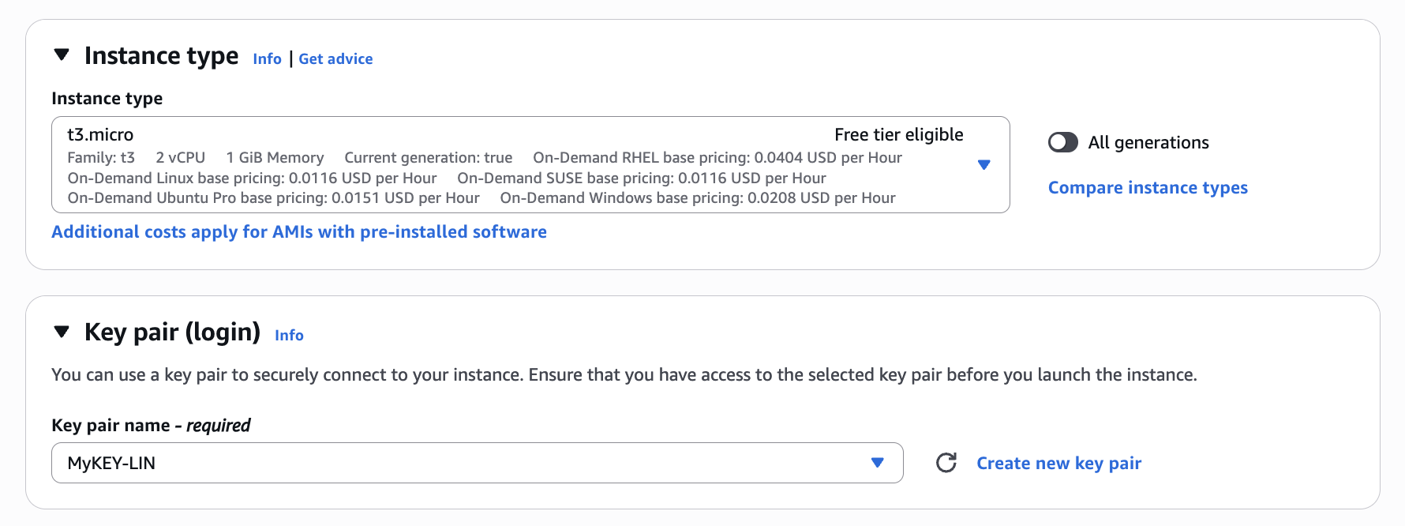
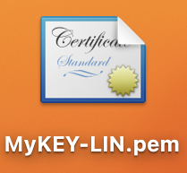
Step 1 – Set Up a Cloud-Hosted Web App (AWS EC2)
Launching the EC2 Instance
Platform: AWS EC2 (Ubuntu 24.04 LTS)
Instance Type: t3.micro (free tier eligible)
Key Pair: MyKEY-LIN.pem (used for secure SSH access)
We launched a t3.micro EC2 instance with Ubuntu 24.04 LTS
A key pair named MyKEY-LIN.pem was generated and downloaded for secure SSH access

Slide 3
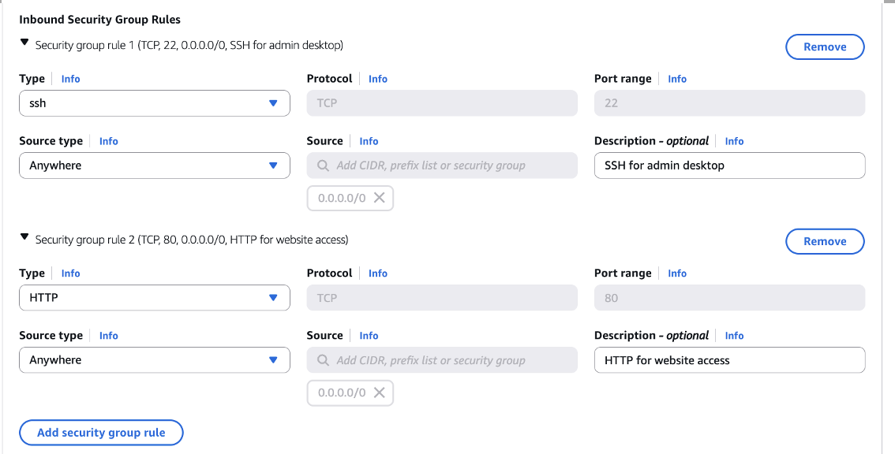
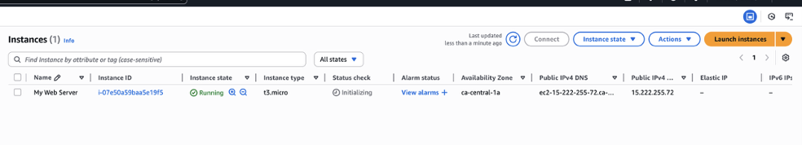
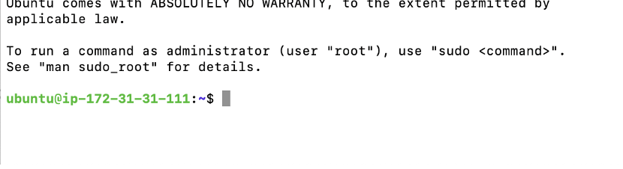
Step 1 – Set Up a Cloud-Hosted Web App (AWS EC2)
Set Security Group Rules
Inbound Rules: Define which types of traffic from the internet are allowed to reach the EC2 instance.
TCP 22 (SSH): Allows remote terminal access for system administration
TCP 80 (HTTP): Allows web browsers to access the hosted site
Source: 0.0.0.0/0 means open to all IPs (only used for demonstration/testing)
Outbound Rules: Outbound rules control traffic from the instance to the internet
Default: All traffic allowed
Default setting permits unrestricted outgoing traffic

Slide 4
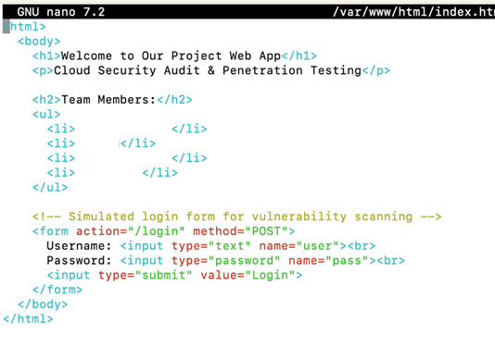
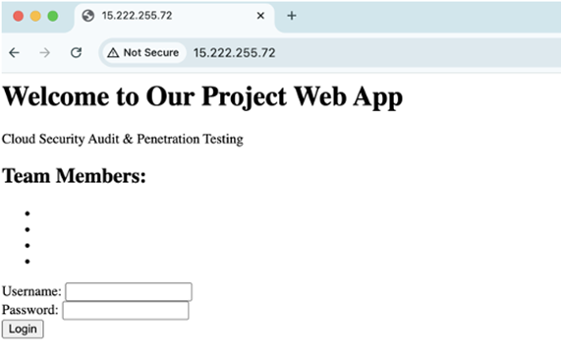
Step 1 – Set Up a Cloud-Hosted Web App (AWS EC2)
Apache2 Web Server Setup
Apache2 is an open-source web server software that allows your EC2 instance to serve web content over the internet. It's one of the most widely used HTTP servers in the world.
Commands Used:
sudo apt update
sudo apt install apache2 –y
Customized index.html：
We customized it with project-specific content (title, team members, and a fake login form) to simulate a real web application for testing purposes.
Public IP：15.222.255.72 （Visit this in a browser to view the hosted project page.） New IP: 35.183.33.147

Slide 5
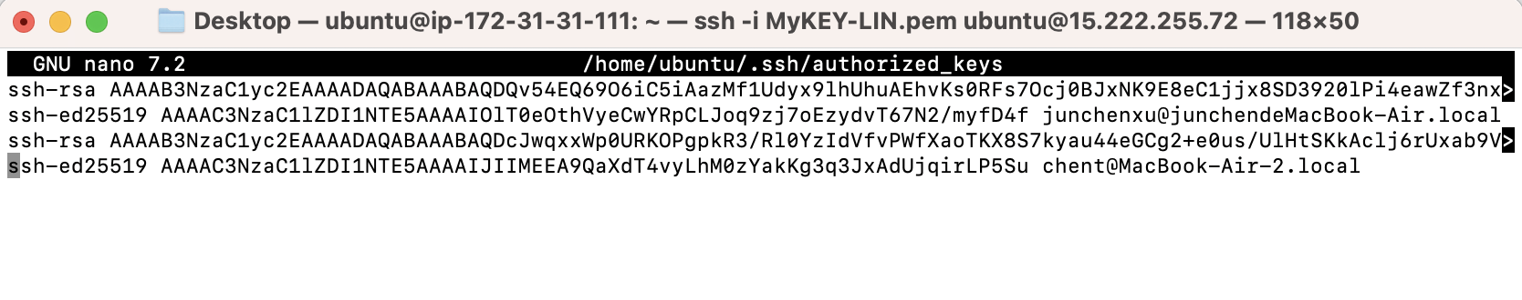
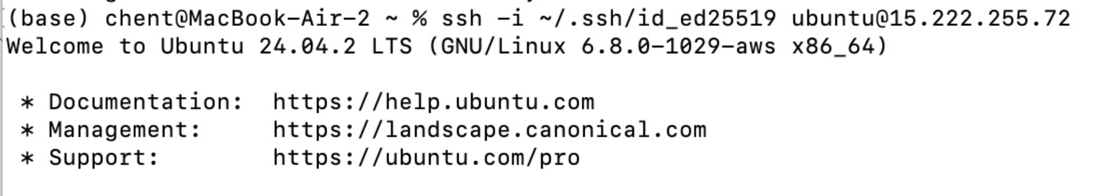
Step 1 – Set Up a Cloud-Hosted Web App (AWS EC2)
SSH Key Configuration for Team Access
Individual SSH Keys: Each team member generated their own SSH key pair (public & private key) on their local machine using tools like ssh-keygen.
authorized_keys File Updated: Added public keys of team members
Private Key Use: Members connect using their private keys
Benefits:
Stronger Security: Eliminates password-based login, resists brute-force attacks
Fine-Grained Access Control: Easy to trace and revoke individual access
Team Collaboration Friendly: Allows each team member to use their own key without sharing credentials

Slide 6
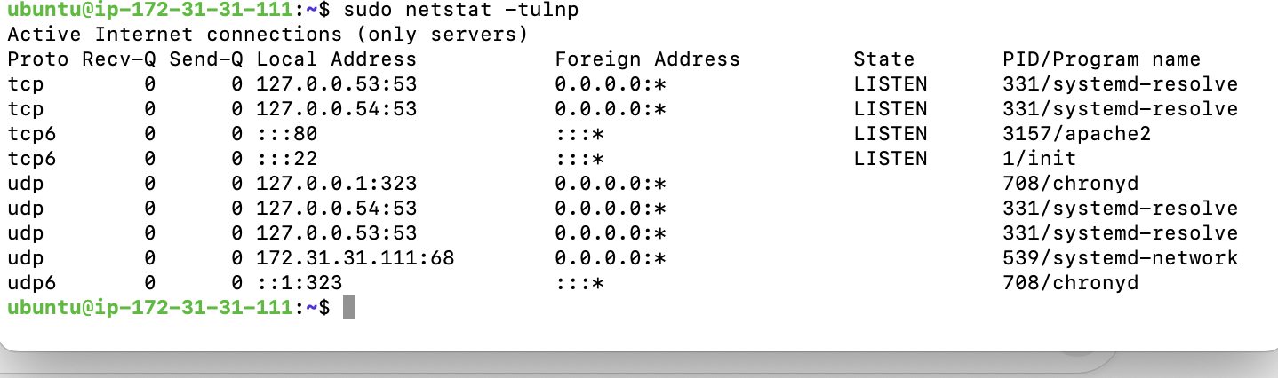
Step 2 – Conducting a Baseline Security Review
Command Used:
sudo netstat –tulnp
Findings:
Port 80 (HTTP) is open：a web server is running
Port 22 (SSH) is open：allows remote administration
Ports 53 (DNS) is open：default DNS caching service on Ubuntu.
Ports 323 and 68 (Chrony/NTP) are open: used for time synchronization; may not be essential for all web apps.
IPv4 (127.0.0.1) and IPv6 (::) active：may increase exposure surface if not needed.
Security Implications:
Port 80 is expected for hosting the web application.
Port 22 is necessary but should be protected using SSH key-based access and Security Group restrictions.
DNS and Time Sync services should be reviewed and disabled if not required to reduce potential attack surface.
This review confirms that only essential ports (80 and 22) are required, while DNS and time services may be optional and should be reviewed.

Slide 7
Step 3 - Vulnerability Scanning Tools
Target IP:
15.222.255.72 (AWS EC2 instance)
Purpose: Identify potential open ports, weak configurations, and exposed services.
Tool | Scan Focus | Key Features
Nmap | Network Layer | Scans open ports, detects services and versions
Nikto | Web Server Layer | Checks for vulnerabilities, outdated software, and misconfigurations.

Slide 8
Step 3 - Nmap Scan_Command
Command | Feature | Result
nmap -sV 15.222.255.72 | Detects open ports & service versions | Found OpenSSH 9.6p1 and Apache/2.4.58
nmap -A 15.222.255.72 | -sV + OS detection, script scanning, http-title, etc | Same service versions + OS fingerprinting + http-title & headers

Slide 9
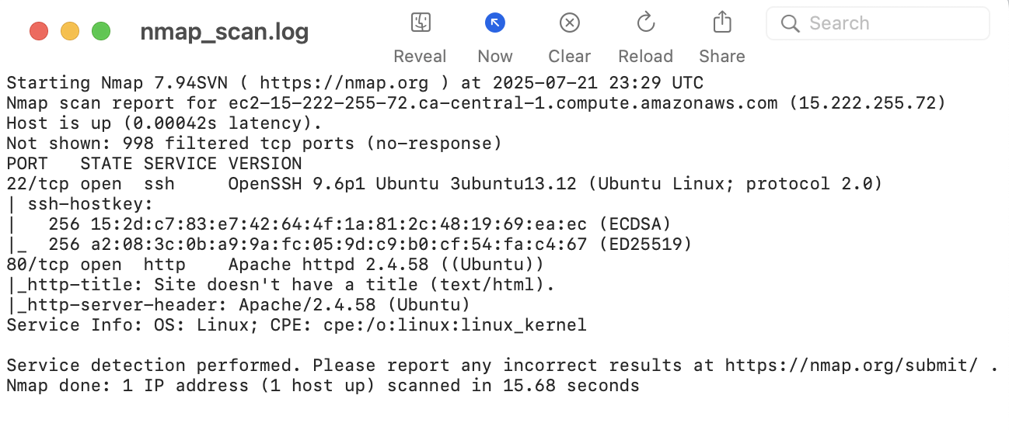
Step 3 - Nmap Scan_Result
Open Ports & Services: may expose the system to known vulnerabilities, especially if outdated versions.
Server & OS Info: may help attackers plan targeted exploits.

Slide 10
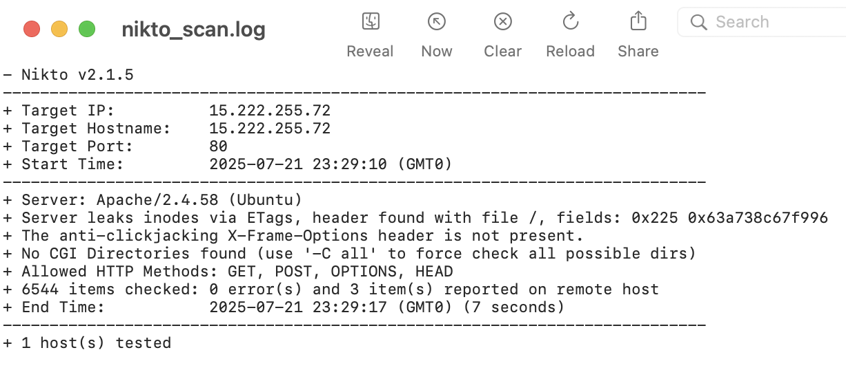
Step 3 - Nikto Scan_Command & Result
Command: nikto -h http://15.222.255.72
Apache server headers expose version info
Missing security headers (e.g., X-Frame-Options)
Directory indexing may expose internal files and sensitive information

Slide 11
Step 4 - Vulnerabilities Analysis
CVSS: Common Vulnerability Scoring System
High: Vulnerabilities that could allow attackers to fully access or control the system.
Medium: Issues that may help attackers exploit the system or gain more access.
Low: Issues that only reveal some information but don’t give direct access.
Vulnerability | Severity Level | Explanation
Open Ports (22, 80) | Medium | Harden with firewall & config
Apache version exposed | Medium | Can help attackers plan exploits
Missing HTTP headers | Medium | Lacks basic web protection
Directory indexing | Medium | May leak internal file structure

Slide 12
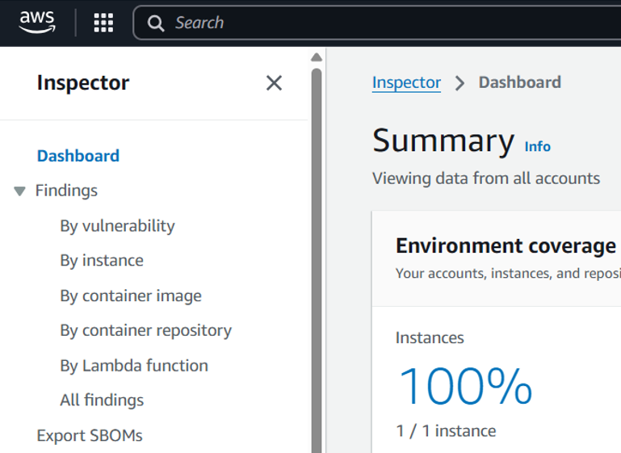
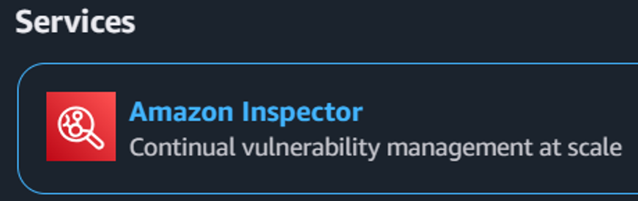
Step 5 - Cloud-Native Tool: AWS Inspector
AWS Inspector is an automated vulnerability management service.
It continuously scans EC2 instances, and It identifies:
Software vulnerabilities (e.g., CVEs)
Network exposure risks

Slide 13
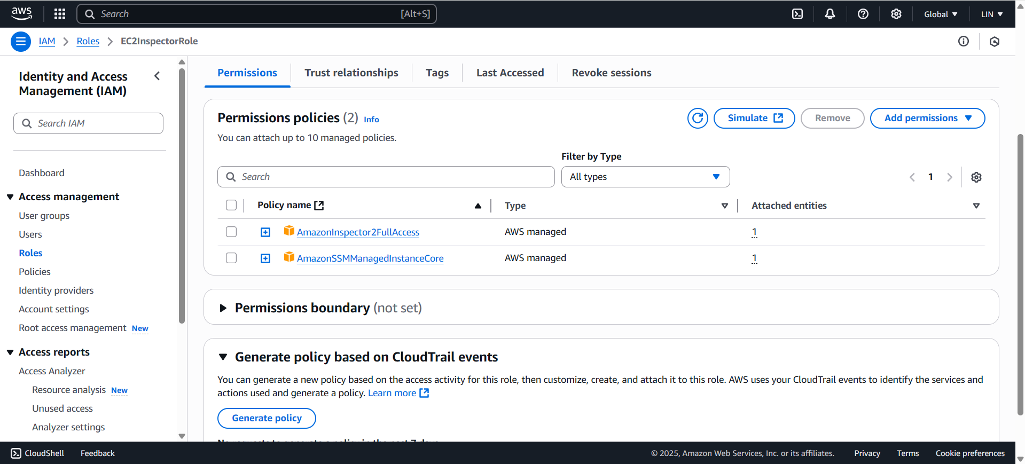
Attached IAM Role with permissions

Slide 14
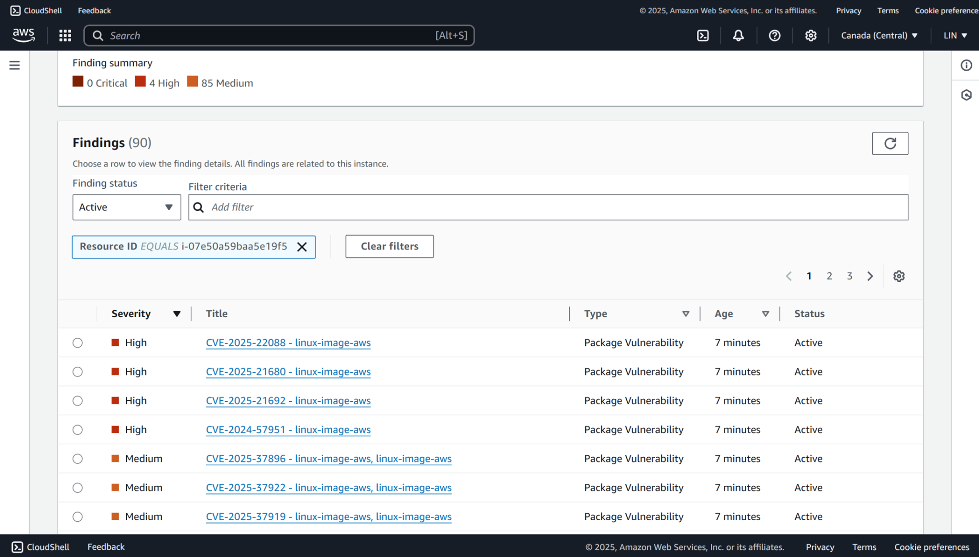
Findings – Vulnerability Summary

Slide 15
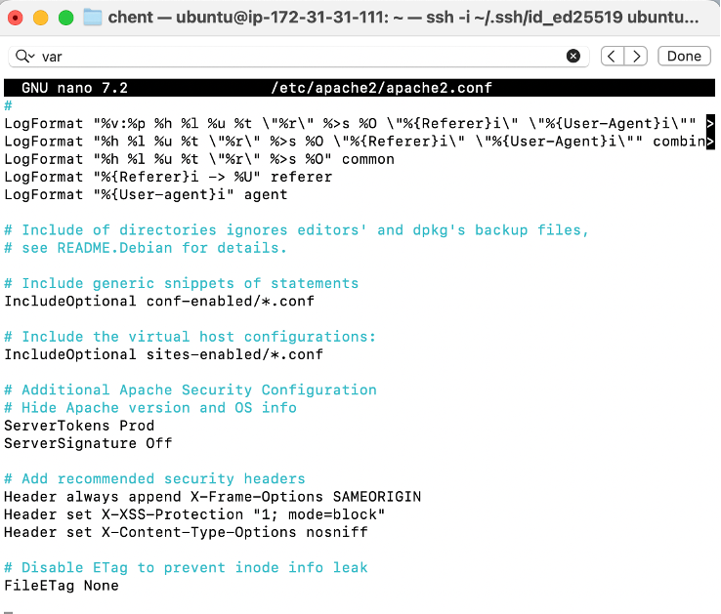
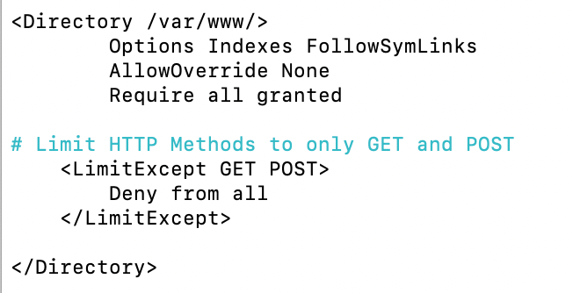
Step 6 - Remediation & Improvement
Remediation Actions for Nmap & Nikto Findings:
Harden Apache HTTP server configuration
Hide Apache version and underlying OS information
Apply essential HTTP security headers:
X-Frame-Options: SAMEORIGIN
X-XSS-Protection: 1; mode = block
X-Content-Type-Options: nosniff
Restrict HTTP methods to only GET and POST
Disable ETag to prevent metadata exposure

Slide 16
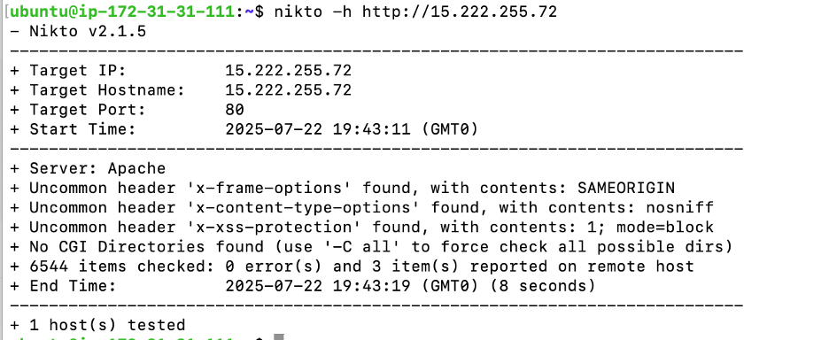
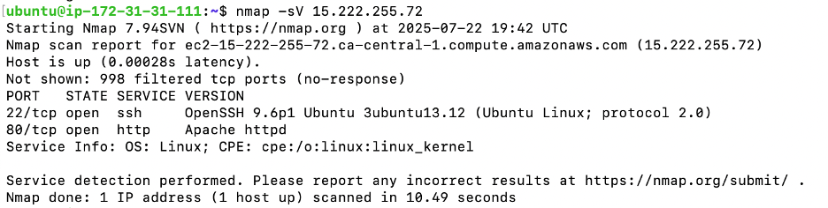
Results after Remediation - Nmap/Nikto:
Issue Identified | Optimized
Apache version and OS info exposed | Hidden
Missing X-Frame-Options header | Implemented: SAMEORIGN
Missing X-XSS-Protection header | Implemented: 1; mode = block
Missing X-Content-Type-Options header | Implemented: nosniff
OPTIONS HTTP method exposed | Restricted: only allow GET/ POST
ETag leaking inode information | Disabled

Slide 17
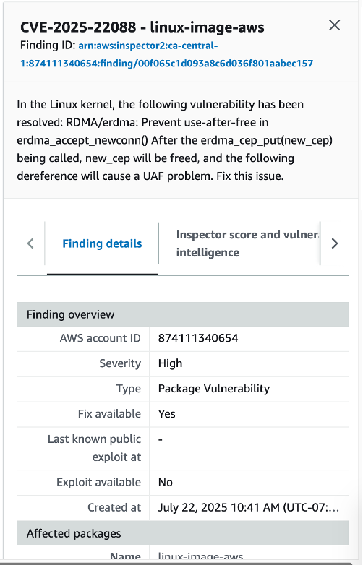
Remediated Inspector Vulnerability:
Resolved Vulnerability: CVE-2025-22088(linux-image-aws):
Severity: High
Vulnerability Type: Use-After-Free in erdma_accept_newconn()
Remediation Steps Taken:
sudo apt-get update
sudo apt-get install --only-upgrade linux-image-aws
sudo reboot
Impact:
Eliminated UAF thread in RDMA/erdma module
Improved kernel-level memory safety
CVSS Score: 7.8 (High)

Slide 18
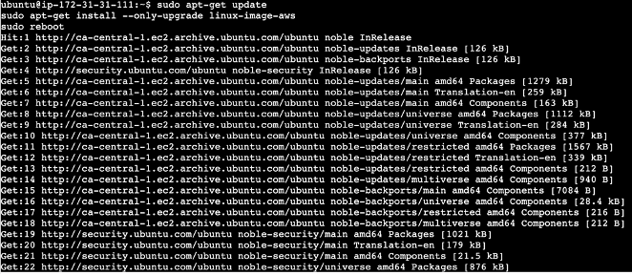
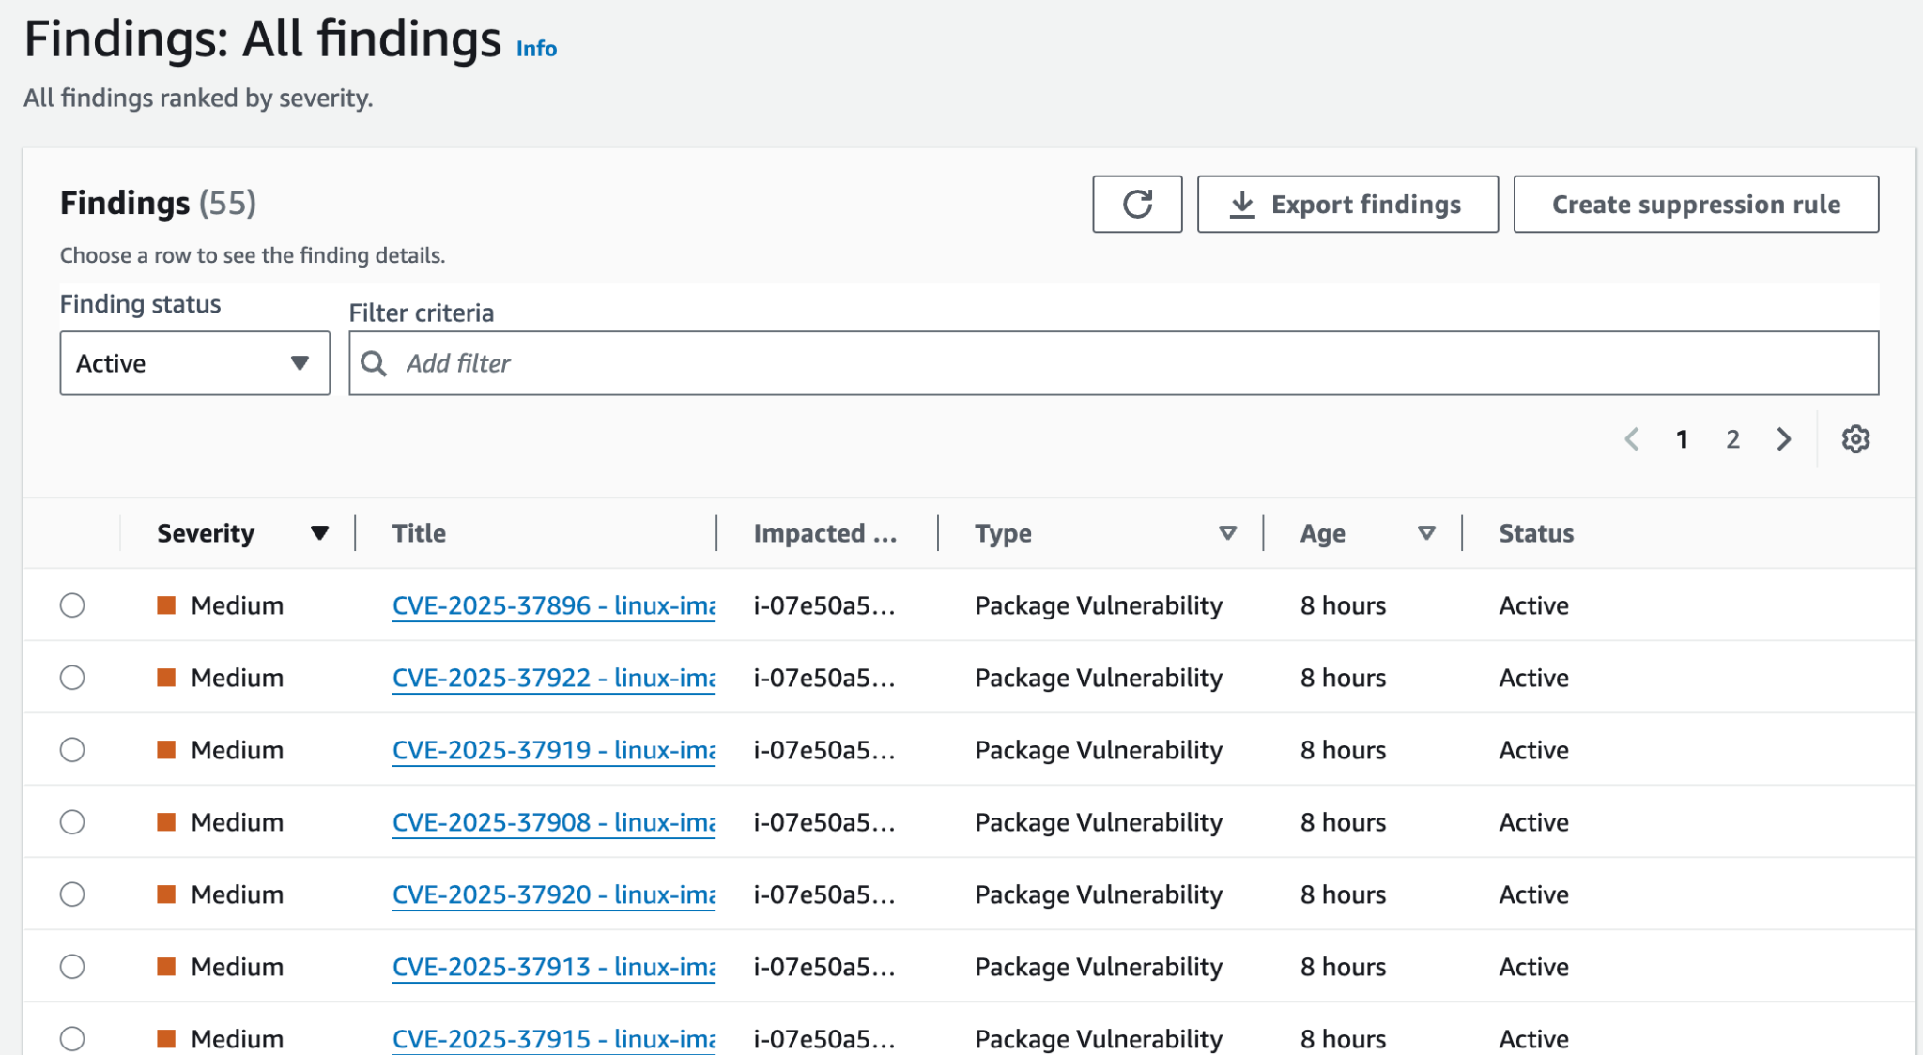
Result:
Successfully remediated 35 vulnerabilities, including 4 high-severity CVEs.

Slide 19
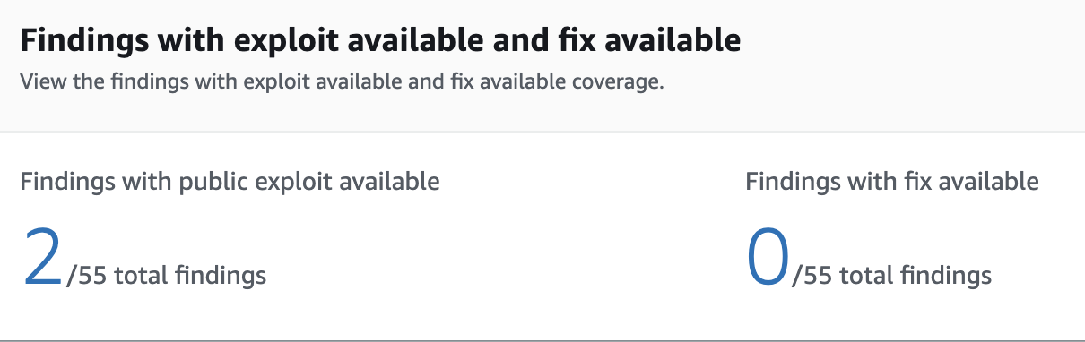
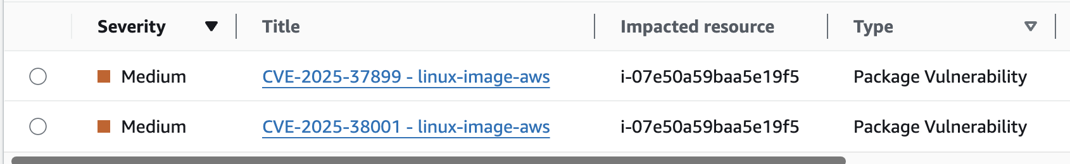
Unpatched Vulnerabilities with Public Exploits
CVE-2025-37899 & CVE-2025-38001 (linux-image-aws)
Severity: Medium
Exploit: Public exploit available
Fix: Not available
Reason: These vulnerabilities affect the AWS kernel version 6.8.0-1031-aws. No official patch has been released yet by Ubuntu or AWS.
Next Step: Keep monitoring security updates. Apply patches once available.

Slide 20
Thank you!

